Slide 1
Digital Image Processing - Project
Haze Removal using Dark Channel Prior
Karandeep Singh Juneja
Prathyakshun Rajashankar

Slide 2
Introduction
Outdoor scenes, in bad weather are usually degraded due to the presence of particles or droplets in the atmosphere. The amount of scattering depends on the distances of the scene points from the camera.
Single Image dehazing is non-trivial because it is highly constrained as the local transmission which depend on the scene depth has to be estimated. To solve this, we use Dark Channel Prior which gives us an effective method to estimate the local transmissions for hazy images.

Slide 3
THE IDEA...
The basic observation is that on haze-free outdoor images, most of the non-sky patches, at least one color channel has very low intensity at some pixels. The low intensities in the dark channel are mainly due to:
Dark objects, shadows of trees and rocks.
Colorful objects Ex- green, red, yellow, blue
Since the natural outdoor images are usually colorful and full of shadows, it is reasonable to generalize the observation.

Slide 4
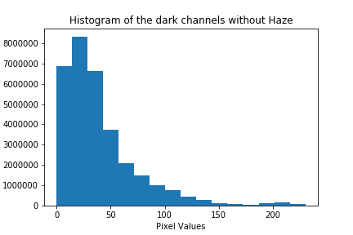
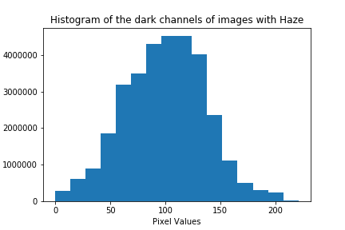
HISTOGRAM
We found the histogram for the dark channels on a collection of outdoor images with and without haze.
The values above 200 are due to the presence of sky in the image.
In contrast, the dark channel of the haze image will have higher intensity in regions with dense haze. Visually, the intensity of the dark channel is a rough approximation of the thickness of the haze.

Slide 5
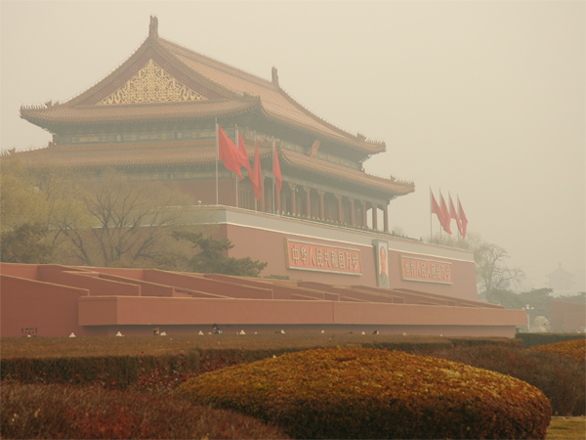
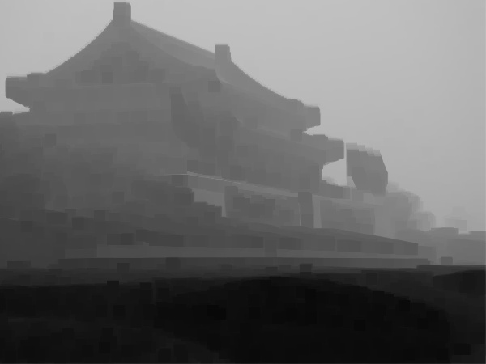
Original Image
Dark Channel

Slide 6
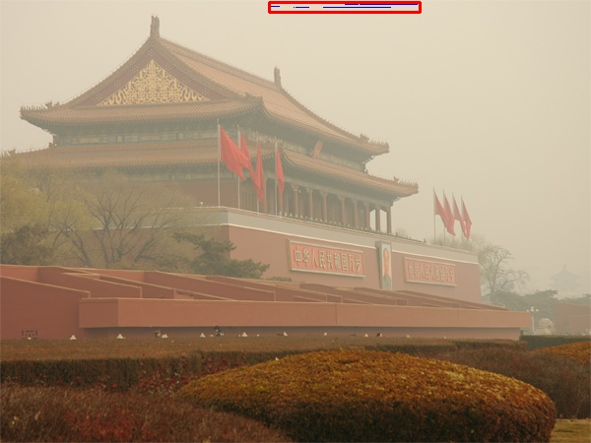
Estimating Atmospheric Light
The dark channel of a haze image approximates the haze denseness. We can use it to estimate the atmospheric light.
We pick the top 0.1% brightest pixels in the dark channel. These pixels are the most haze opaque. Among these pixels the pixel with the highest intensity in the Image is selected as the atmospheric light.
This method is better than picking the brightest pixel. Since, in images, the brightest pixel could be on white objects.

Slide 7
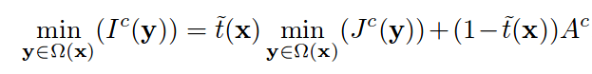
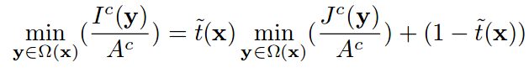
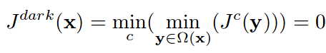
Estimating the Transmission
Taking min operation in the local patch on the haze imaging equation
I is the observed intensity. J is the scene radiance. A is the atmospheric light. t is the transmission map describing the portion of the light that is not scattered and reaches the camera
According to dark channel prior, the dark channel of the haze-free J tends to 0

Slide 8
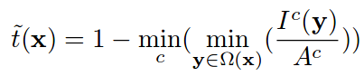
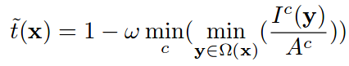
Estimating the Transmission
Substituting J to be 0, we get
In general, the atmosphere has particles and there seems to be little haze when we look at far off objects. Presence of haze helps to perceive some depth. Hence, we can keep a small amount of haze for distant objects
ω (0<ω<1) is a parameter.

Slide 9
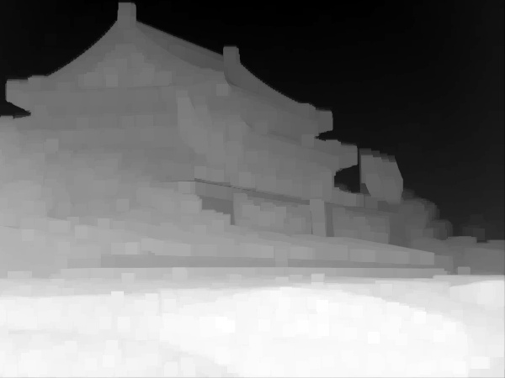
Dark Channel
Estimated Transmission Map

Slide 10
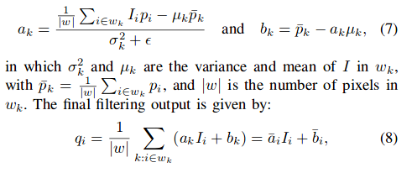
Guided Filter
There are some block effects since the transmission is not always constant in a patch. We refine the transmission map using guided filter. Guided filter is a type of edge-preserving smoothing operator, which filters the input image (Estimated transmission map) under the guidance of another image(Original image).
The filtered output q, as a function of the input image p and guidance image I is calculated as:

Slide 11
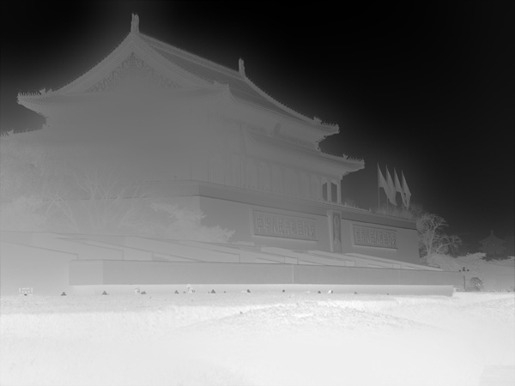
Transmission Map before
Transmission Map after guided filter

Slide 12
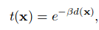
Depth Map
Using the transmission map, a depth map can also be constructed for the scene. When the atmosphere is homogenous, the transmission t can be expressed as:
where β is the scattering coefficient of the atmosphere. This equation indicates that the scene radiance is attenuated exponentially with the scene depth d

Slide 13
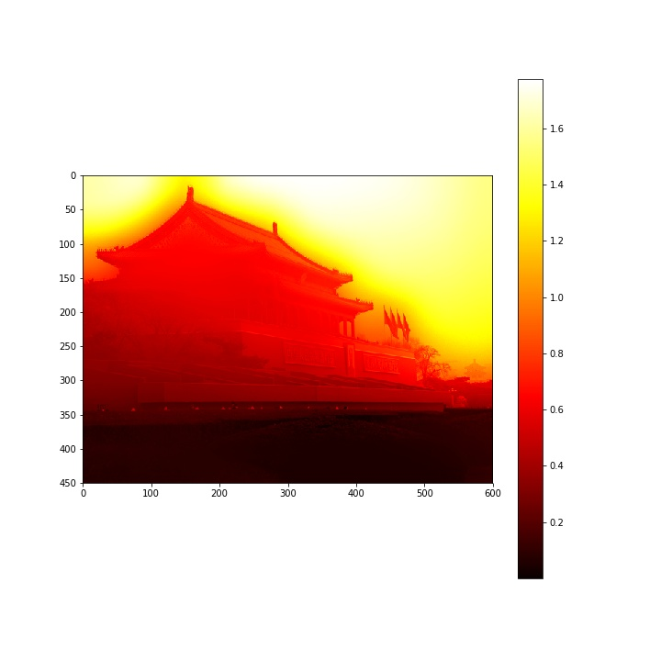
Transmission Map
Depth Map

Slide 14
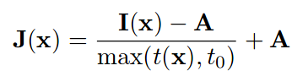
Recovering the Scene Radiance
We use the haze equation model to recover the image scene. Since J(x)t(x) can be very close to 0 when the transmission t(x) is close to 0. We restrict the transmission t(x) to a lower bound t₀ to preserve some small amount of haze in very dense haze regions.

Slide 15
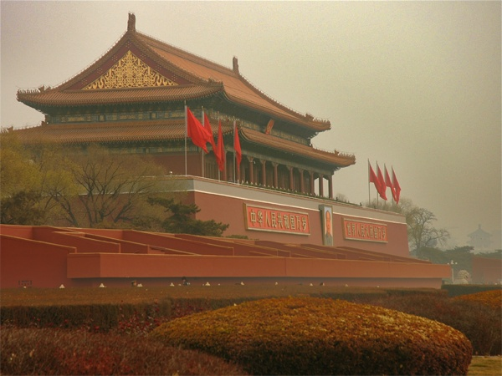
Image before Dehazing
Image after recovering scene radiance

Slide 16
Color Balancing
Since the scene radiance is usually not as bright as the atmospheric light, the image after haze removal looks dim.
The simple color balancer helps in color enhancement and contrast enhancement. It works by stretching the values of the values of the three channels R,G and B so that they occupy the maximal possible range [0,255] and provide some contrast.
However, there might be some pixels already having a value of 0 or 255. In such cases, we clip the pixels to some Vmin and Vmax by saturating the pixel values below Vmin and above Vmax. Then we stretch the pixels to [0,255] to obtain the contrast.
If there is a scene dominated by Red and Green light, the color balancing would enhance the blue channel making the ambient light lose the yellowish hue.

Slide 17
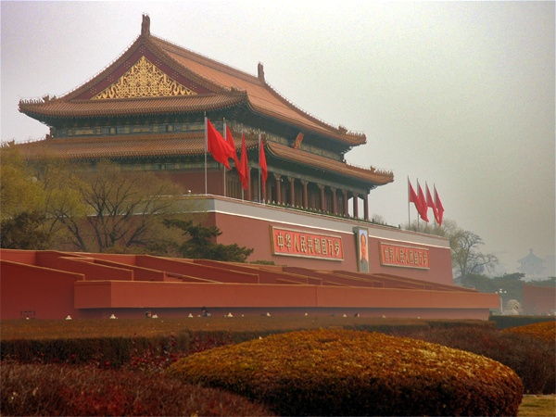
Image after recovering scene radiance
Image after color balancing

Slide 18
Input
Final Output

Slide 19
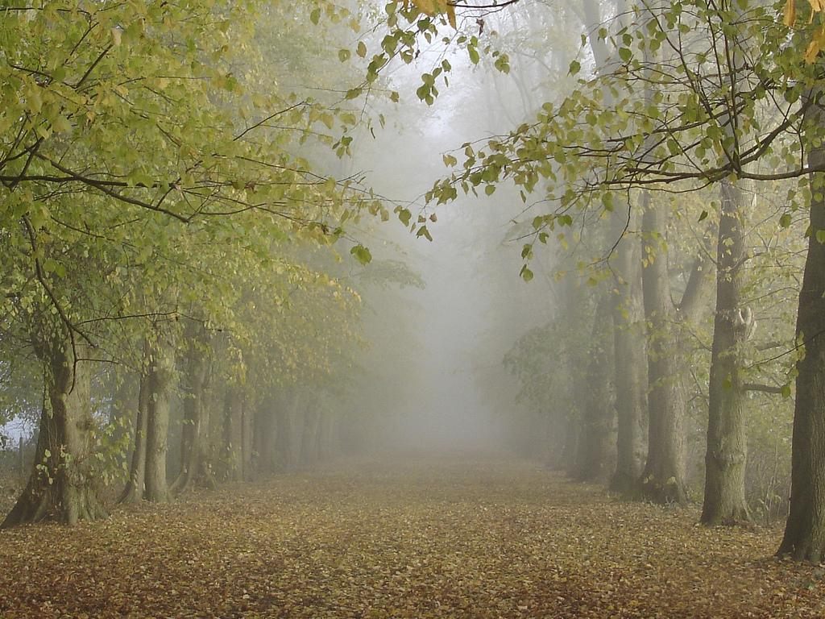
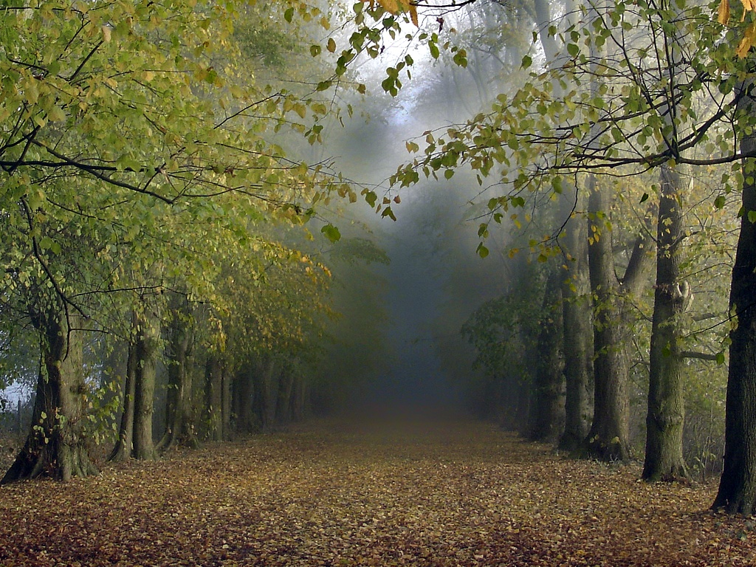
Input
Output

Slide 20
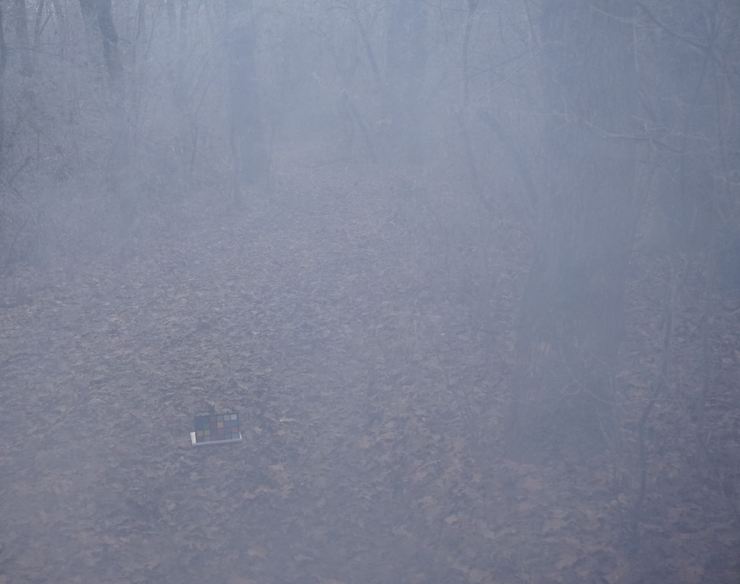
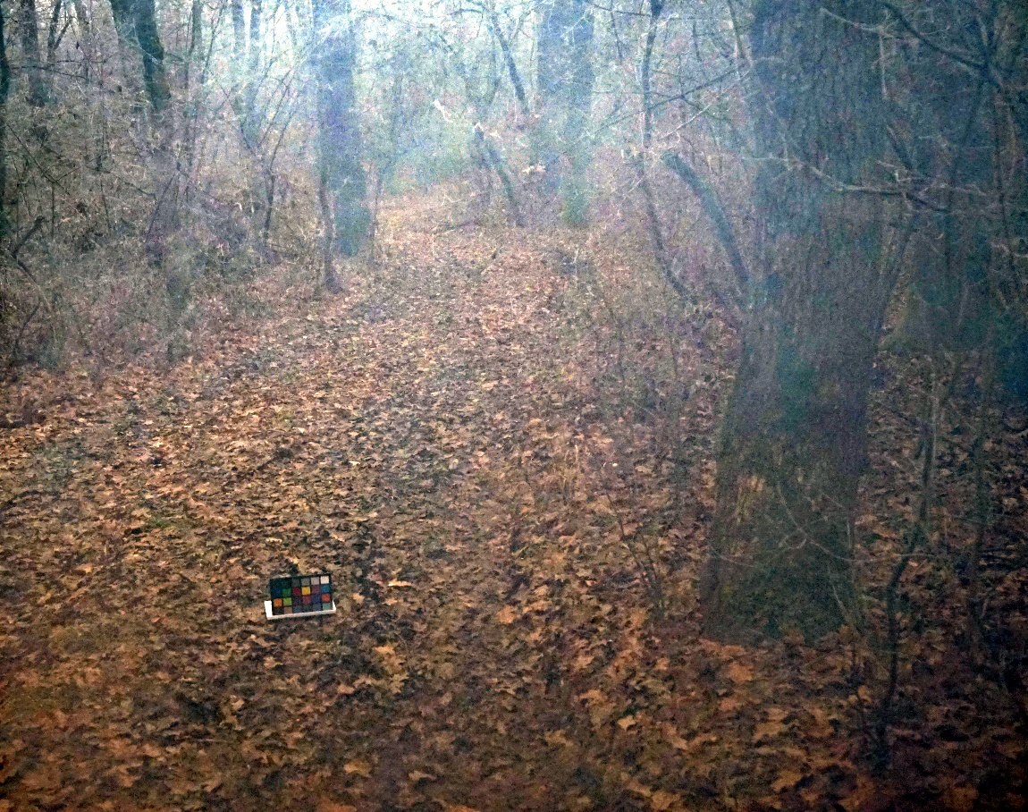
Input
Output

Slide 21
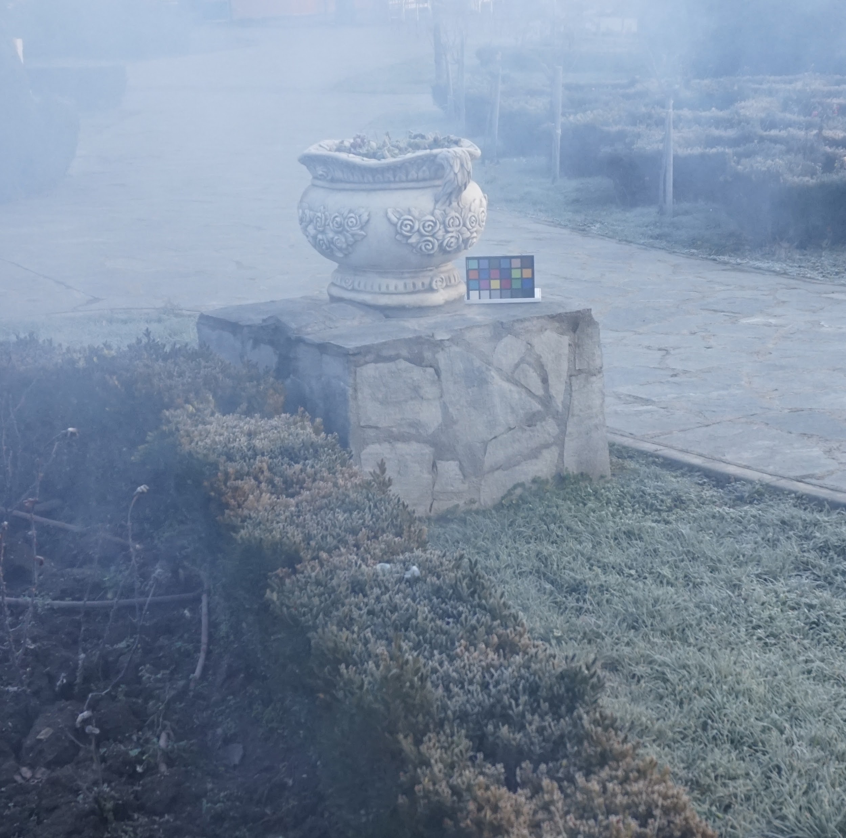
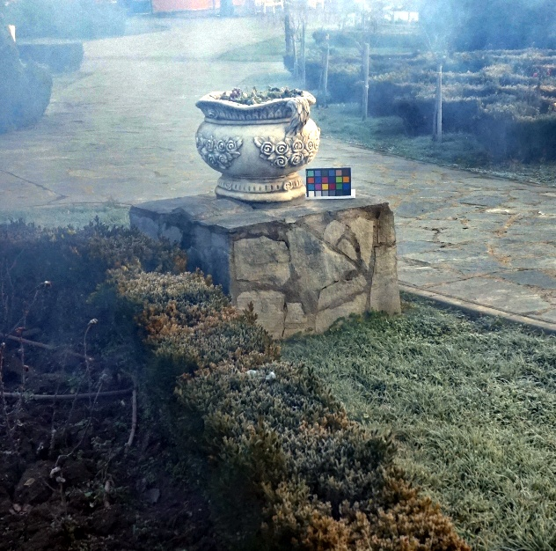
Input
Output

Slide 22
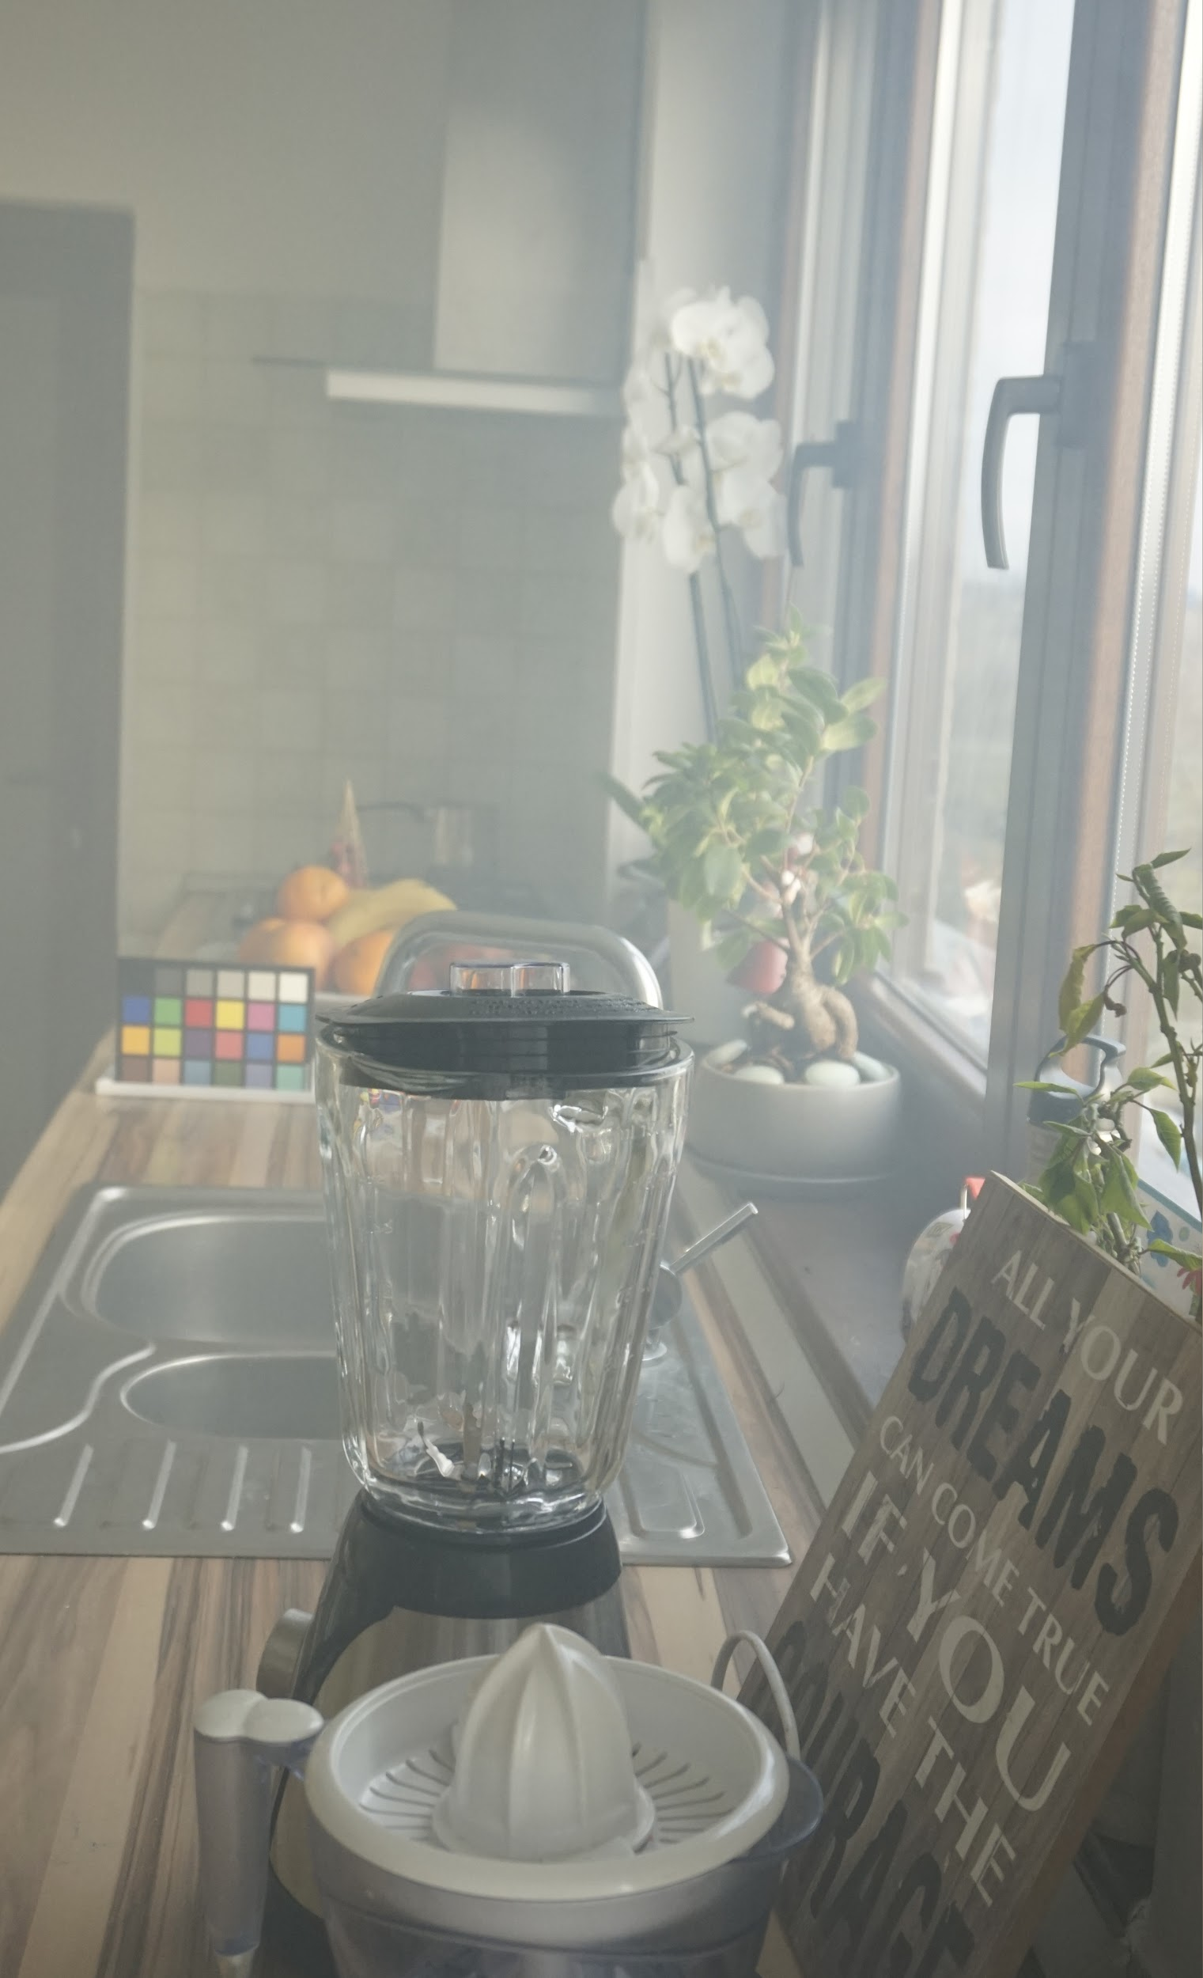
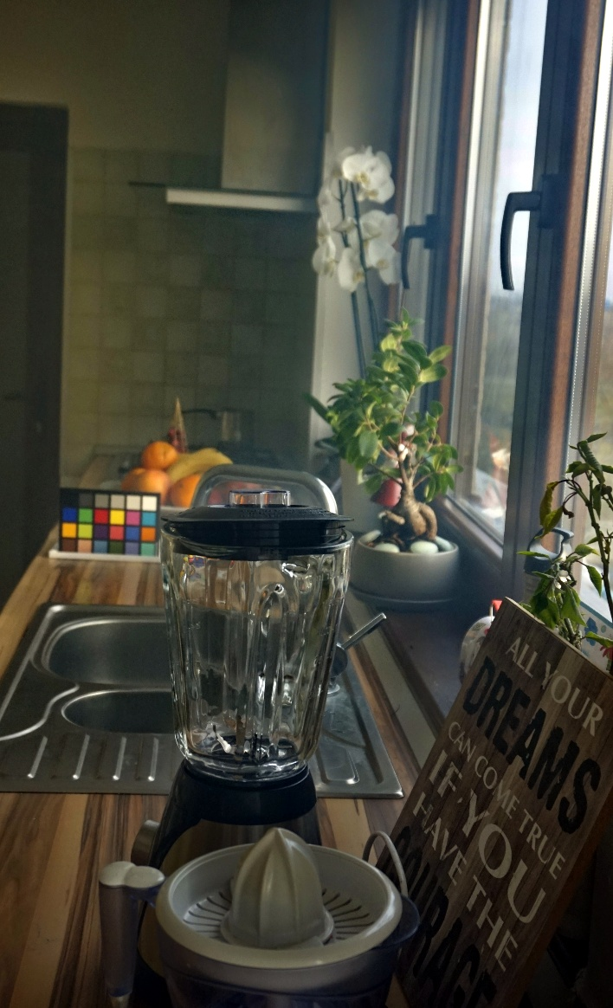
Input
Output

Slide 23
Parameter Tuning
There are certain parameters in the algorithm that had to be set to some constant value.
Window size for dark channel computation.
ω , a constant multiplied during transmission estimation.
t₀ , lower bound in the transmission map.
Radius of the guided filter.
The algorithm was run on various values of the parameters and compared the results with the ground truth on about 45 images using PSNR(Peak Signal to Noise Ratio). Higher the value of PSNR, better the restoration.

Slide 24
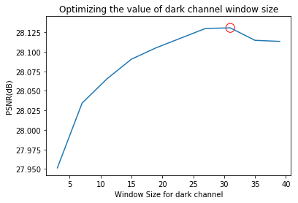
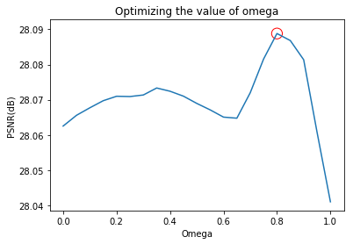
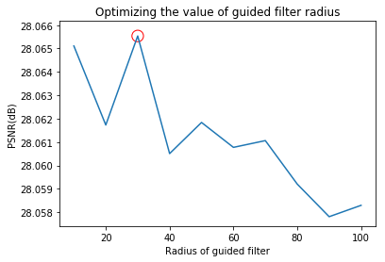
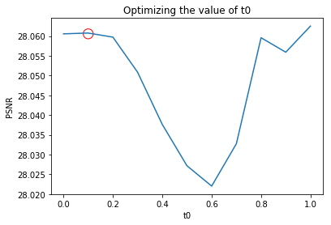
Best value : 31
Best value : 0.8
Best value : 30
Best value : 0.1

Slide 25
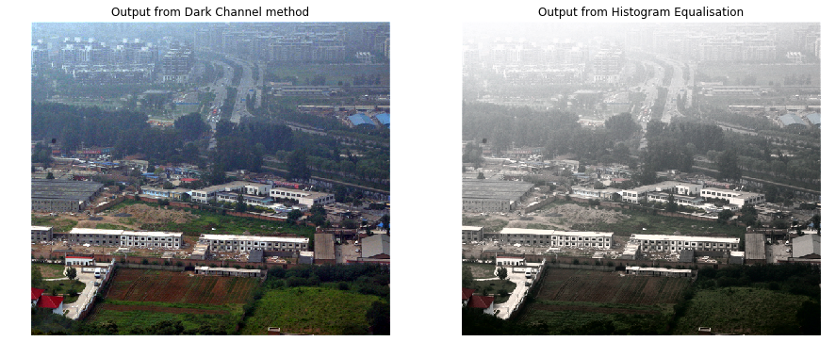
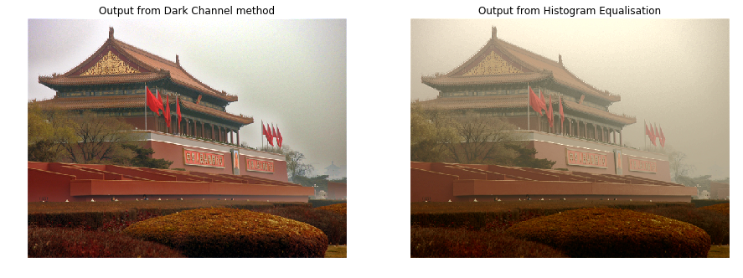
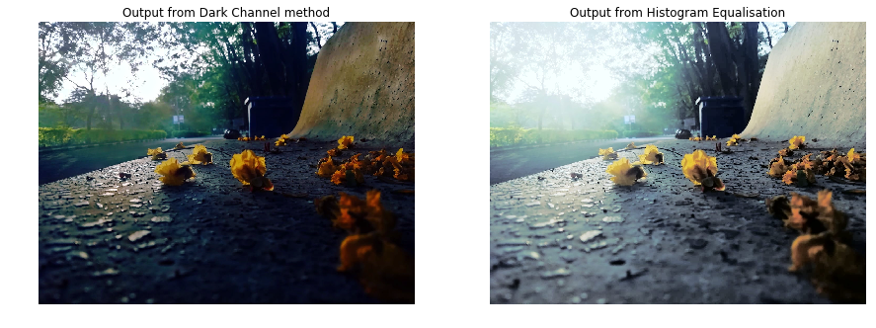
Comparison with Histogram Equalization
Histogram equalization was performed on the Y channel of the YCbCr color space, because haze reduces the contrast of the image, which histogram equalization might fix.
Histogram equalization does a bad job at haze removal, sometimes actually amplifying the haze. It also messes with the colors of the objects, which is not desirable.

Slide 26
Failure Cases
When the scene contains light color patches like reflections, the airlight estimation becomes very poor. This happens most commonly in indoor images where there can be lights and reflections. Because of this, the result suffers from color shift in the hazy regions.
Since the dark channel prior assumption only works when haze is the brightest object in the dark channel, the algorithm fails if there is a prominent white object/light in the picture that is brighter than the haze.
It also fails when the haze is tinted with some color (say due to sunlight). Due to the presence of the color, the dark channel of the haze becomes darker.

Slide 27
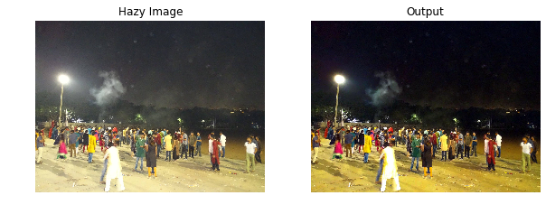
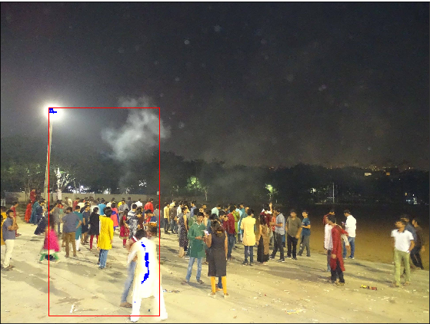
The 0.1% brightest pixels were found in the white clothes and light instead of the haze/smoke.

Slide 28
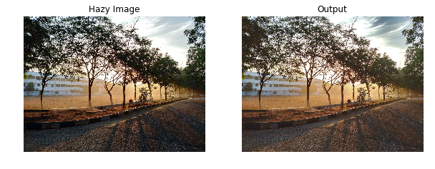
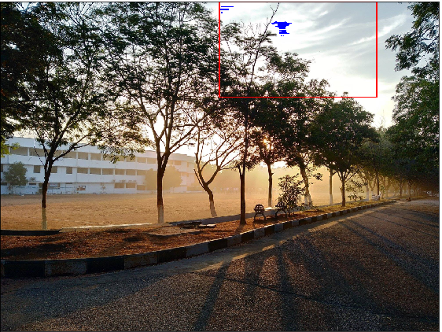
Since the haze is tinted yellow, it's dark channel value is low. The atmospheric light is chosen from the clouds and the yellowish haze is not removed.

Slide 29
Future scopes
Try coming up with algorithm for haze removal in night time, remote sensing and underwater images.
For underwater images, the dark channel assumption does not hold true since the haze is blue.
For night-time images, it becomes a challenge to remove the artificial colors on objects due to various colored light sources.
For remote-sensing images, the haze might be very thick and removing such haze with this algorithm will lead to certain artifacts. Moreover, due to the uniformity of haze in such images, the depth map prediction would be inaccurate.

